Slide 1
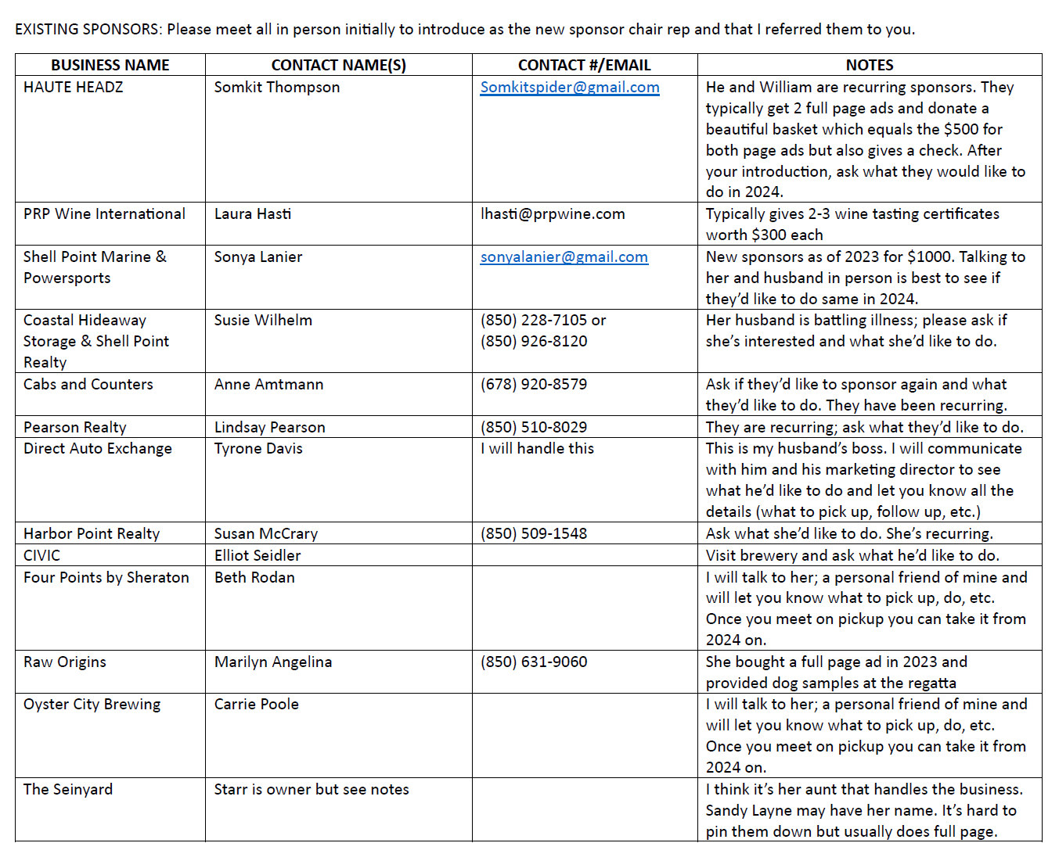
PREVIOUS SPONSORS/DONORS
Mails it to you
You can get a certificate for the storage unit, get a check from her and she’ll want two ads
cabsandcounters@gmail.com
Vlisa.norton@directautoexchange.com
Lisa Norton & Tyrone Davis
Definitely mention that Gena Thomas handled this last year & ask what they’d like to do.
Lisa is the Marketing person who will put the full-page ad together & hand over a check. Last year Tyrone donated $500
Ask for Lesley Andrews
(850) 422-0071
Typically, they put together a really awesome gift basket which equals a full-page ad
You can contact her through Pensacola Street OC but she’s back and forth on the new Apalachicola branch. Leave a message, she’ll call you back.

Slide 2
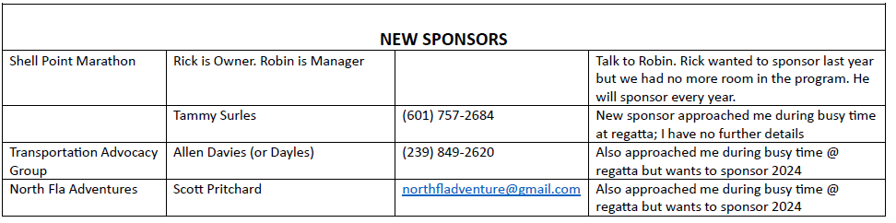
Ask for Rick
They WILL sponsor; you have to talk to Rick, the manager
They wanted to sponsor a couple yrs ago but there was no room left in the program

